Slide 1

AI IN CANCER
INTELLIGENCE OF BIOLOGICAL SYSTEMS 1

Slide 2
GROUP NO - 12
S HARI SANKAR(AM.EN.U4AIE21056)
K.SUBHASH(AM.EN.U4AIE21036)
SAI MANASA SOWMYA (AM.EN.U4AIE21057)
R RAKESH (AM.EN.U4AIE21052)
CHARISHMA AKSHAYA (AM.EN.U4AIE21051)

Slide 3

TABLE OF CONTENTS
AI IN CANCER
TREATEMENT
AI IN CANCER
DETECTION
01
02
03
04
05
INTRODUCTION
BREAST CANCER
PREDICTION
CONCLUSION

Slide 4
01
INTRODUCTION

Slide 5
Cancer refers to any one of a large number of diseases characterized by the development of abnormal cells that divide uncontrollably and have the ability to infiltrate and destroy normal body tissue.
Cancer often has the ability to spread throughout your body. Cancer is the second-leading cause of death in the world. But survival rates are improving for many types of cancer, thanks to improvements in cancer screening, treatment and prevention.
Technological advancements in AI and ML have paved the path towards autonomous disease diagnosis tools by utilizing big data sets to meet the future challenges for human disease detection at a very early stage specially in cancer.

Slide 6
ML is the subset of AI, where neural network base algorithms are developed to allow the machine to learn and resolve problems like the human brain AI is growing by leaps and bounds. Research on clinical oncology is now more focused to decode the molecular onset of cancer by understanding the complex biological architecture of cancer cell proliferation.
Artificial intelligence (AI) is concretely reshaping our lives and it is time to understand its evolution and achievements to model future development strategies. This is true also for oncology and related fields, where AI is now opening new important opportunities for improving the management of cancer patients.

Slide 7
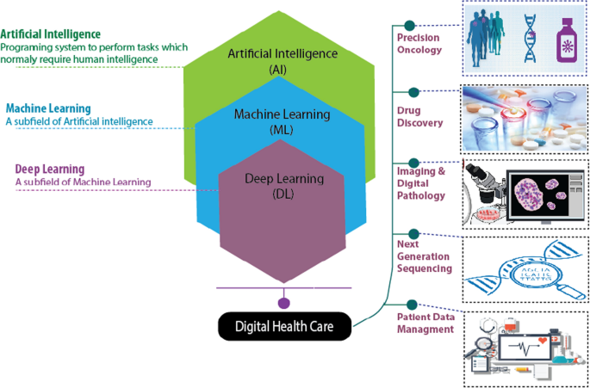

Slide 8
02
AI IN CANCER DETECTION

Slide 9
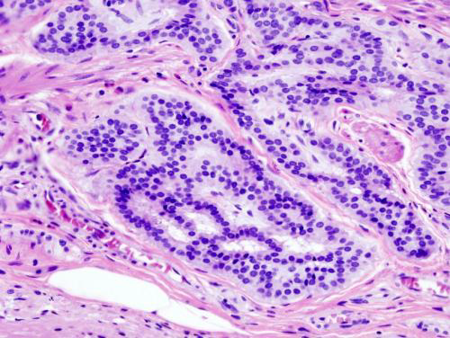
“Early detection of cancer is the key to saving the lives of patients.”
The use of AI in cancer detection has been expanding over the years. Not only AI can catch cancer earlier but also it is used for increasing the accuracy of detection. Research has developed many machine learning algorithms which detect cancer by analyzing tissue scans and as well or better than pathologists.
One such model was developed in the United States which can recognize the images of colorectal cancer which is one of the most common causes of cancer-related deaths across Europe and US. The research gathered over 13,000 images of colorectal cancer and using these images a machine learning algorithm was developed. This algorithm scored an accuracy of 98% whereas the accuracy of detection of colorectal cancer by pathologists was 96% .
Histopathologic image of colonic carcinoid

Slide 10
AI can also advance existing technologies to improve patient outcomes. With the help of machine learning algorithms, we can accurately predict whether a person will or will not have cancer by just analyzing the characteristics of the tumor .

Slide 11

03
BREAST CANCER PREDICTION USING ML

Slide 12
With the data set for breast cancer provided by UCI machine learning, we have developed a prediction model using logistic regression algorithm.
In this model firstly we are applying data analysis techniques in which various characteristics of tumor are analyzed. Machine learning algorithms use linear algebra and probability to find relationships between the various properties of tumors developed and the diagnosis which tells whether the person has a benign or malignant tumor .
The data set contains the following characteristics of tumor:

Slide 13
radius (the distance from the center to the circumference of the tumor)
texture (standard deviation of gray-scale values)
perimeter (circumference of the tumor, approx. 2*3.14 *radius)
area
age
diagnosis: 0 or 1 indicating whether patient has breast cancer or not
smoothness (local variation in radius lengths)
compactness
concavity (severity of concave portions of the contour)
symmetry
fractal dimension

Slide 14
Firstly, we are breaking the data set into two parts, one for training the logistic regression model and the other part for testing the data set and predicting the accuracy of the model.
The predictions that we made gave an accuracy of 94.6% on the training model and an accuracy of 94.4% for the testing model.
Furthermore the accuracy of these predictions can be increased by the usage of advanced AI algorithms like Neural networks etc which will increase the accuracy of detection.According to researchers, by combining mammography capabilities and AI, the technology can significantly reduce the workload for radiologists, and improve patient outcomes
Github Repo Link

Slide 15

04
AI IN CANCER TREATEMENT

Slide 16
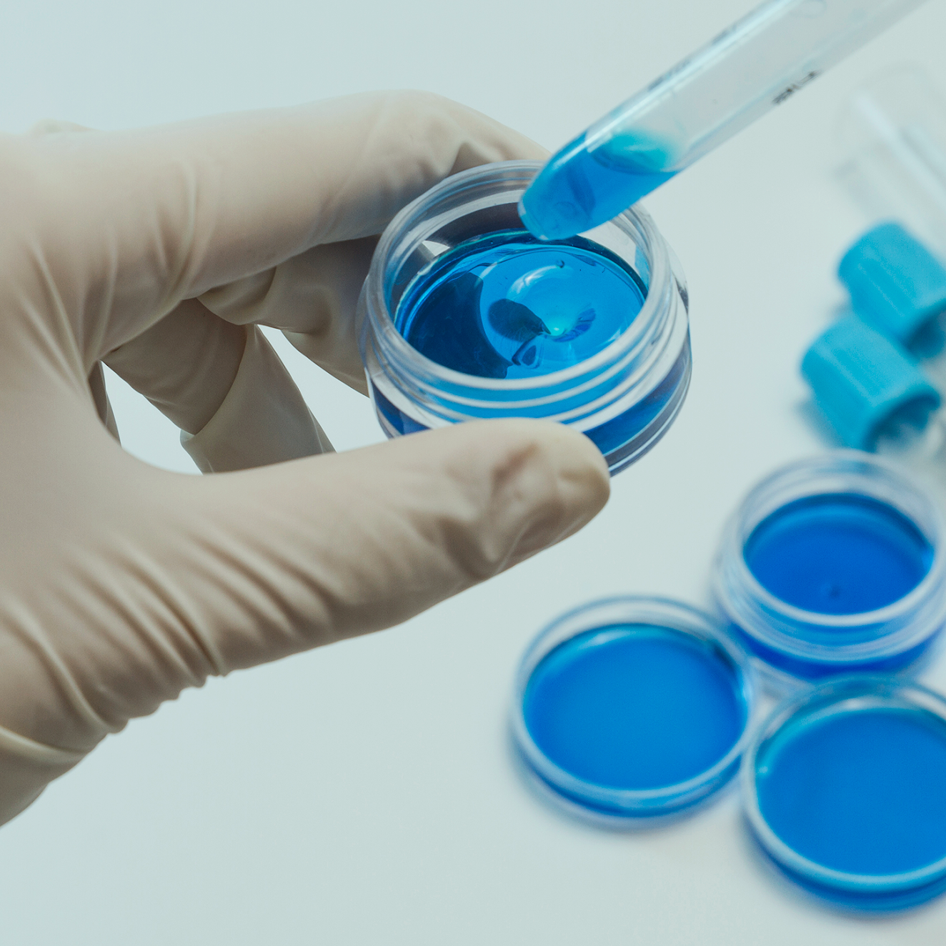
I. Personalized cancer medicine
By applying AI and machine learning to multiple data sources, researchers are taking first steps toward developing personalized treatments for diseases from cancer to depression.
Here, AI is in action today and making great strides in cancer treatment by leveraging patient medical history and tumor characteristics to help generate multiple treatment options. Cancer is a disease caused by mutations or damage to genes. If the gene is damaged our body is damaged.
The term personalized medicine means that for an individual the medical care is based on that individual’s genes and that individual’s specific disease.

Slide 17
Many cancer affects or involve specific genes Personalized cancer care arises from the studies of human genes and genes in different cancers. Researchers have also used genetic information to develop treatments for cancer and ways to prevent it. Since personalized healthcare is more specific to an individual, it will have lesser side effects than other types of treatments.
With the help of AI and machine learning algorithms we can generate personalized treatments such as personalized radiation therapy. Traditional radiation therapy is delivered to patients uniformly. Dosing Guidelines do not take information about a patient’s individual risk factors or tumor characteristics into consideration on treatment.
The main aim of personalized radiation therapy is that with the help of a patients medical imaging data and clinical risk factors machine learning and AI can generate a unique radiation for each patient .This will further minimize side effects and reduce treatment failures by a large margin.

Slide 18
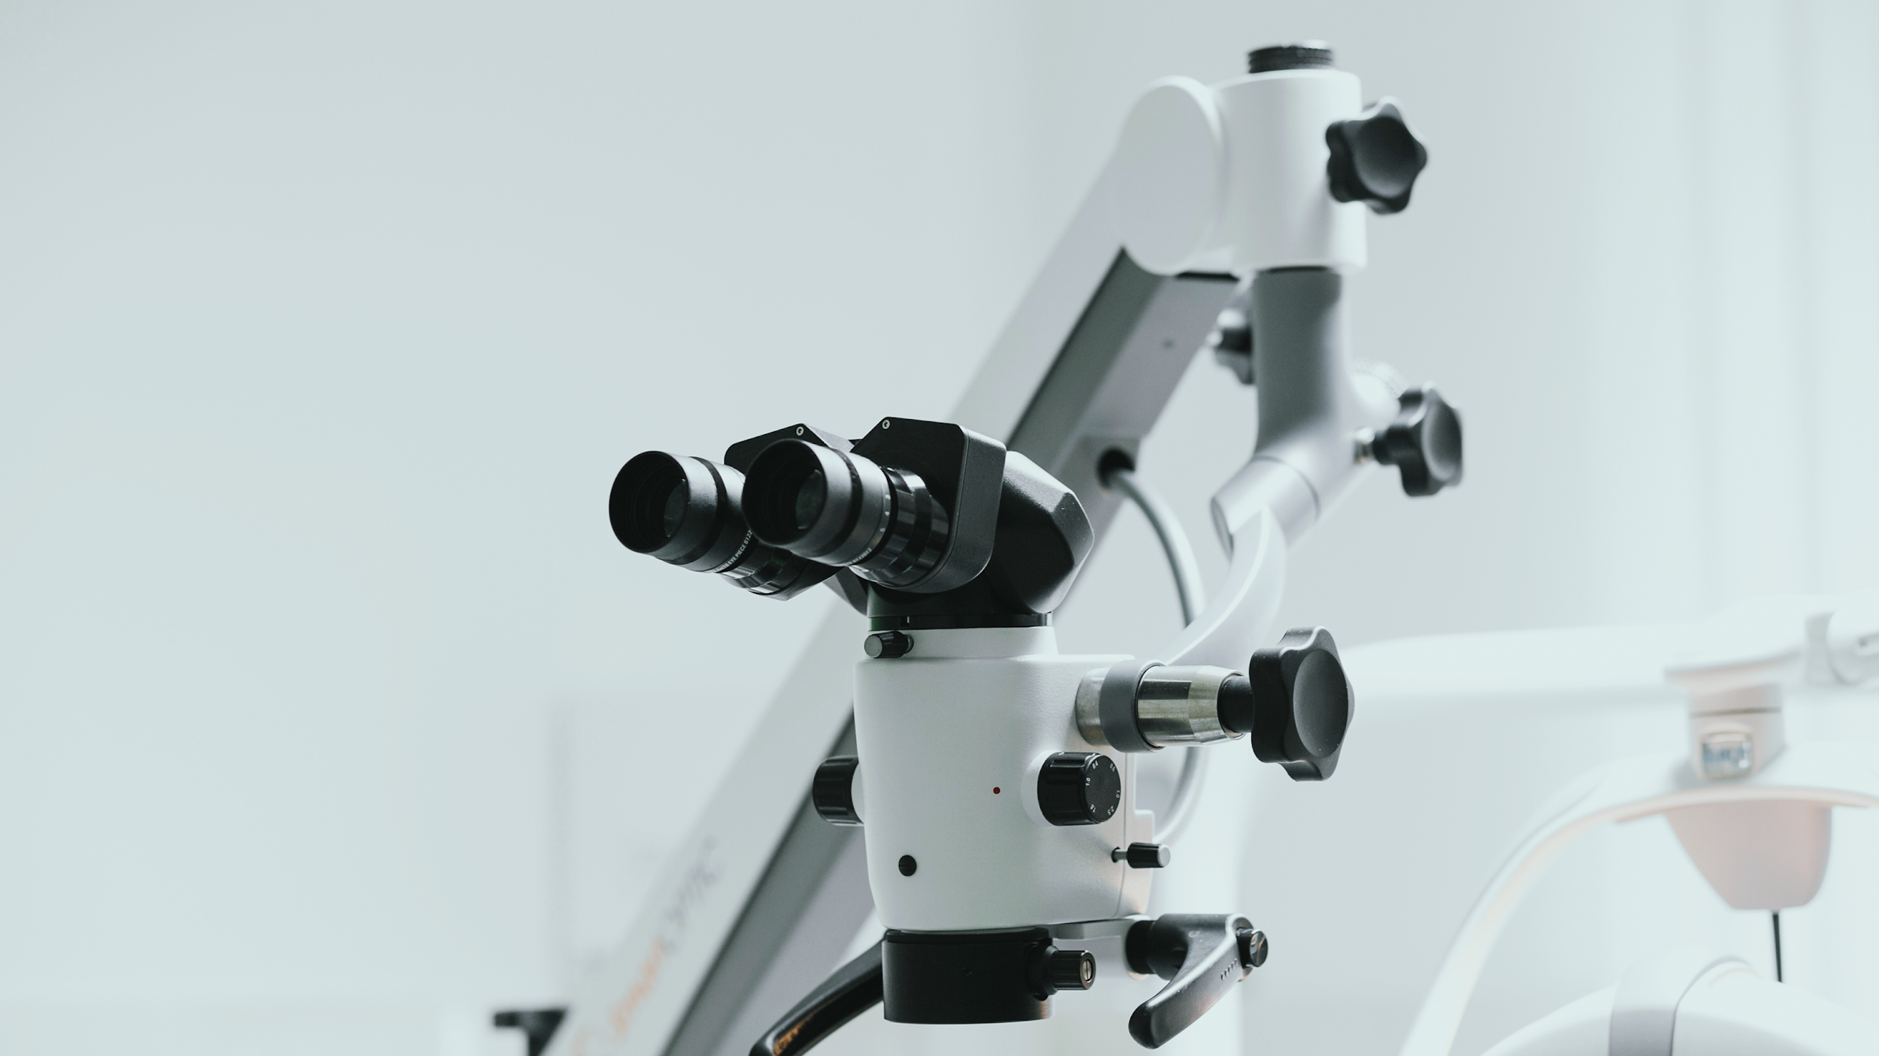
II.AI in cancer drug development
Another Way in which AI can help in the treatment of cancer is in the field of cancer resistant drugs.
The application of AI and machine learning can be applied in various stages of drug development including the chemical structure of drugs, target validation and investigating drug trials and managing clinical trials.

Slide 19
Many deep learning algorithms are being used to sift through millions of molecules in a single day which normally takes up to 2 months.
Different cancers and the same drugs may have different reaction modes and data from high-throughput screening procedures often reveal the relationship between genomic variability of cancer cells and drugs.
AI can quickly understand how cancer cells become resistant to cancer drugs by learning and analyzing data on large drug-resistant cancer, which can help improve drug development and adjust drug use activity .

Slide 20
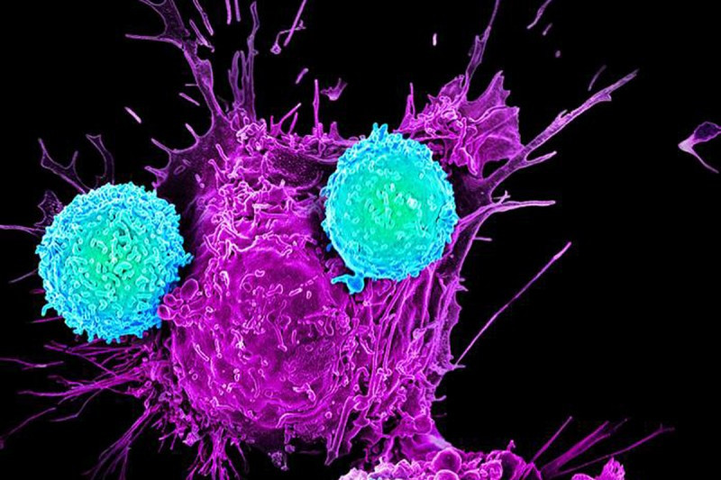
III.AI in immunotherapy
AI application in immunotherapy mainly focuses on evaluating the effects of different treatments and helping doctors adjust their prescriptions. A research team at UT Southwestern Medical Center and MD Anderson Cancer Center built an AI-powered technique for identifying which neoantigens (peptides produced by mutations in cancer cells’ genomes) are recognized by a patient’s immune system.

Slide 21
Such AI algorithms would allow predicting cancer cells' response to immunotherapies. Our immune system’s T cells are constantly watching for signs of cancer and other invading bodies. When these cells recognize neoantigens, they bind together.
However, some neoantigens remain unrecognized, allowing cancer to grow. There are tens of thousands of types of neoantigens. Analyzing their ability to trigger T cells’ response is a tedious, costly, and time-consuming task. With the help of machine learning, this is becoming possible.
Having this knowledge would allow researchers to develop personalized T cell-based therapies and cancer vaccines, and it will help predict patients’ response to immunotherapies.

Slide 22
III.AI enabling genome sequencing
Genomic sequencing is used in two different areas: chronic hereditary disorders and oncology. By using the algorithms that are part of our artificial intelligence, we can spot the origin of a genetic mutation causing a cancer or a particular condition and then give an idea of what the best drug treatment would be to the attending physician.
The process begins with the extraction of the patient’s DNA via a blood draw or biopsy. The hospital then uses molecular biology processes to prepare the samples and subsequently digitizes them using a DNA sequencer. The resulting genomic data is then submitted to an AI which is developed .
The AI then digs around to identify the patient’s genomic mutations and get drug treatment regime recommendations for individual patients. The more hospitals use the analytics platform, the more patients’ genomic profiles are accumulated, and the smarter the AI gets.

Slide 23
CONCLUSION
05

Slide 24
Benefits of applying AI in cancer detection and treatment-
Personalizing
therapies
Eliminating cancer
overtreatment
01
03
Identifying
tumor types
without the need
for invasive procedures
Reducing false
positives and negatives
02
04

Slide 25

AI should be seen as something that helps cancer specialists spend less time on routine tasks, reduce variabilities and minimize human errors. Artificial intelligence is a powerful tool, which can save patients’ lives and physicians’ time.
AI can sift through large data sets and also aid in decision making rather than be a standalone tool for diagnosing patients in a completely unsupervised environment.
Oncology can be a great example in which humans and technology can work together thereby producing magnificent results and also providing the best treatment for cancers.
AI could speed up the discovery of new materials, a move that could dramatically accelerate the development of anticancer drugs. It is believed that AI will be a powerful driving force for human cancer research and treatment in the future.

Slide 26
REFERENCES
Alkhaldi, Nadejda. “AI in Cancer Detection and Treatment: Applications, Benefits, and Challenges — ITRex.” ITRex, 22 October 2021, https://itrexgroup.com/blog/ai-in-cancer-detection-treatment-applications-benefits-challenges/#. Accessed 6 February 2022.
“Artificial intelligence in cancer diagnosis and prognosis: Opportunities and challenges.” PubMed, 28 February 2020, https://pubmed.ncbi.nlm.nih.gov/31830558/. Accessed 6 February 2022.
Bakre, Manjiri. “AI In Cancer Care: How It's Making a Difference In Treatment And Care.” Entrepreneur, 23 December 2020, https://www.entrepreneur.com/article/362227. Accessed 6 February 2022.
“Breast-Cancer-Prediction-using-Logistic-Regression/Breast_Cancer_Prediction using Logistic Regression.ipynb at master · pratikkaushik14/Breast-Cancer-Prediction-using-Logistic-Regression.” GitHub, https://github.com/pratikkaushik14/Breast-Cancer-Prediction-using-Logistic-Regression/blob/master/Breast_Cancer_Prediction%20using%20Logistic%20Regression.ipynb. Accessed 6 February 2022.

Slide 27
“Clinical applications of artificial intelligence and machine learning in cancer diagnosis: looking into the future - Cancer Cell International.” Cancer Cell International, 21 May 2021, https://cancerci.biomedcentral.com/articles/10.1186/s12935-021-01981-1#Sec1. Accessed 6 February 2022.
“Clinical applications of artificial intelligence and machine learning in cancer diagnosis: looking into the future - Cancer Cell International.” Cancer Cell International, 21 May 2021, https://cancerci.biomedcentral.com/articles/10.1186/s12935-021-01981-1. Accessed 6 February 2022.
““Top Opportunities for Artificial Intelligence to Improve Cancer Care.” HealthITAnalytics, 29 November 2021, https://healthitanalytics.com/features/top-opportunities-for-artificial-intelligence-to-improve-cancer-care. Accessed 6 February 2022.

Slide 28

THANK YOU

